Slide 1
Evaluating the Strategies of Statement Selection in Automated Program Repair
Deheng Yang¹, Yuhua Qi², and Xiaoguang Mao^{1,3}
¹ National University of Defense Technology
² Beijing Institute of Tracking and Communication Technology
³ Laboratory of Software Engineering for Complex Systems (National University of Defense Technology)
Nov. 23rd
In SATE 2018

Slide 2
CONTENTS
Introduction (FL and APR)
Evaluation metrics
Experimental setup
RQs and evaluation
Discussion and conclusion

Slide 3
1. Introduction
Fault Localization
Patch Generation
Patch Verification
Valid Patch

Slide 4
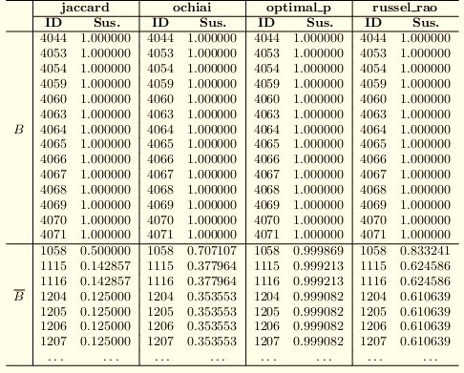
1. Introduction
BACKGROUND
Fault localization (FL) accuracy affects the effectiveness of automated program repair (APR) and needs to be improved in automated program repair.
APR techniques has two strategies to select statements for modifications:
Rank-First Algorithm (RFA) : a deterministic algorithm focusing on ranking accuracy (e.g., Nopol, ACS, SimFix)
Suspiciousness-First Algorithm (SFA): a stochastic algorithm focusing on suspiciousness accuracy (e.g., Genprog, RSRepair, HDRepair)
Notes:
1）Effeciency? 我认为应该是efficiency才对，不应该是effectiveness
2） (e.g., SoFix, saner 2016.) 其中对FL在APR中提出了要求，希望得到改进
3）(including suspiciousness accuracy and rank accuracy)
RFA-based repair tools directly select Statement₃ as the first target statement and produce candidate patches by modifying Statement₃. If these patches are invalid, they then select next top ranked statement (i.e., Statement₉) as target statement. In contrast, for SFA-based repair tools, the probability of each statement being selected relies on its suspiciousness. That is, every suspicious statement has the chance to be selected first, but Statement₃ has the largest chance to be selected as the first target statement.

Slide 5
1. Introduction
OUR WORK
Empirically compare the effectiveness of SFA and RFA in automated program repair:
2 evaluation metrics: NCP and patch diversity
44 buggy programs: from Defects4J
6 FL techniques: Ochiai, Jaccard, Barinel, Op2, Tarantula, Dstar
4 APR tools: Nopol, jMutRepair, jKali, SimFix
Interesting findings:
SFA: better in parallel repair and patch diversity
RFA: better when evaluated by NCP
SFA can be improved by increasing the suspiciousness accuracy
Notes:
2）此外是不是应该把SFL改成FL呢，要提一下SFL吗。
1）要谈一下prior work吗
是不是应该做一个表格来清楚的表示和prior work的区别呢
This paper builds on our prior work [14], studying more repair tools with different repair approaches and conducting further statistical analyses. The new findings facilitate future usage of statement selecting strategies as well as open a new avenue for improving fault localization in automated program repair, especially for the SFA-based tools (see Section 2.2). The rest of the paper is organized as follows. Section 2 first presents the background and related work. Section 3 introduces the three research questions, and Section 4 describes the design of our experiment. Section 5 presents the evaluation of the result data. Section 6 presents further discussions on SFA and RFA. Conclusions and future work are described in Section 7.

Slide 6
2. Evaluation Metrics
NCP
PATCH DIVERSITY
The Number of Candidate Patches generated before a valid patch is found (NCP)
The lower NCP score obtained, the better effectiveness of the repair tool, which indicates the better performance of the statement selecting strategy deployed in the repair tool
Data Collection: 100 independent repair trials for each bug and FL techniques
The number of inequivalent validated patches found in a certain number of independent repair trials
we believe that more inequivalent fixes can provide more clue information to assist developers in eliminating bugs
Data Collection: also collected from the repeated trials for each bug and FL
Notes:
为什么要补丁多样性。
因为我觉得现在的修复工具，在缩小search space的时候，比如simfix就在同一个项目内搜索补丁，在提高速度的同时，我认为也降低了自己的修复能力。
在未来，search space可以变大的情况下，我认为这种patch diversity是很有意义的。
For the patch diversity metric that also requires an enough number of repeated runs, we extract and count the inequivalent valid patches from the patch information of 100 independent trials for each benchmark program.
1）这里还应该好好关心一下
到底怎么提取的patch diversity
通过补丁所修改语句 + 人工核对的方式。
如果要核对正确性的话，工作量就更大了，还需要比较语法上的等价之类的，很麻烦。

Slide 7
3. Experimental Setup
OVERVIEW

Slide 8
3. Experimental Setup
REPAIR TOOLS IMPLEMENTATION
Tool selection: RFA-based tools can be transformed into SFA-based tools, but not vice versa (e.g., Genprog, HDRepair).
Tool modification:
Suspiciousness conversion
Random selection
Statement removal
SUBJECT PROGRAMS
Benchmark:
Defects4J
For Nopol, jMutRepair, jKali and SimFix, 44, 9, 9, and 7 bugs are selected randomly without any bias from the bugs that can be repaired by each APR tool.
Notes:
1) For the selected tools, Nopol, jKali and jMutRepair are well-developed with an active GitHub community and extensively used in previous studies [25, 26, 27, 28, 29], while SimFix implements the state-of-art repair approach to successfully fix the largest number of bugs in Defects4J compared to other automated program repair technologies [40].
All the tools we select are RFA-based tools that go through the suspicious rank list from the most suspicious statement to the least suspicious statement. The reason why we do not select SFA-based tools is that SFA-based tools cannot be transformed into RFA-based tools (see Section 6). For example, jGenprog, which can also be obtained from Astor [10], is an SFA-based tool that relies on SFA to perform the mutation operator in automated program repair due to the genetic programming algorithm [16], and thus cannot be converted into RFA-based tools.
2) Then step 1), 2) and 3) will be iterated until the rank list is empty, or a valid patch is found, or the time limit expires.

Slide 9
4. RQs and Evaluation
RESEARCH QUESTIONS
RQ1: Does there exist a statement selecting strategy achieving statistically significantly better performance than the other under the measurement of NCP metric?
RQ 2: If so, why does this strategy achieve better performance than the other?
RQ 3: Does SFA outperform RFA in patch diversity?
STATISTICAL TESTS
Qualitatively: Mann-Whitney-Wilcoxon test
Quantitatively: Vargha-Delaney A-test

Slide 10
4. RQs and Evaluation
RESULT OF RQ1
The different performance of RFA under the measurement of NCP.
The higher efficiency of SFA in parallel repair.
Fig. 1. NCP distributions of SFA- and RFA-based SimFix on reparing the 7 bugs with 6 different FL techniques

Slide 11
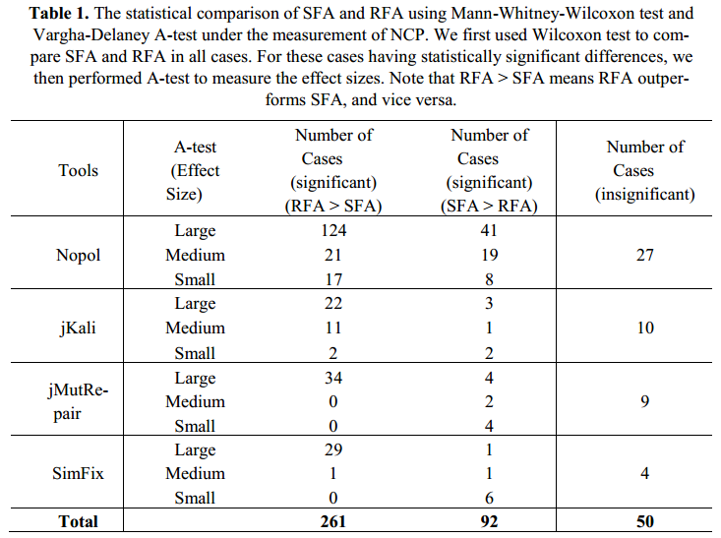
4. RQs and Evaluation
RESULT OF RQ1
The better performance of RFA under the measurement of NCP.

Slide 12
4. RQs and Evaluation
RESULT OF RQ2
Our finding:
Flat scores (low suspiciousness accuacy)
A new experiment:
To manually improve the suspiciousness accuracy of Ochiai to obtain “Och-New”
Result:
the low performance of SFL is caused by the suspiciousness inaccuracy and can be improved.

Slide 13
4. RQs and Evaluation
RESULT OF RQ2
Our finding:
Flat scores (low suspiciousness accuacy)
A new experiment:
To manually improve the suspiciousness accuracy of Ochiai to obtain “Och-New”
Result:
the low performance of SFL is caused by the suspiciousness inaccuracy and can be improved.
Fig. 1. The NCP distribution of SFA from Ochiai and “Och-New”

Slide 14
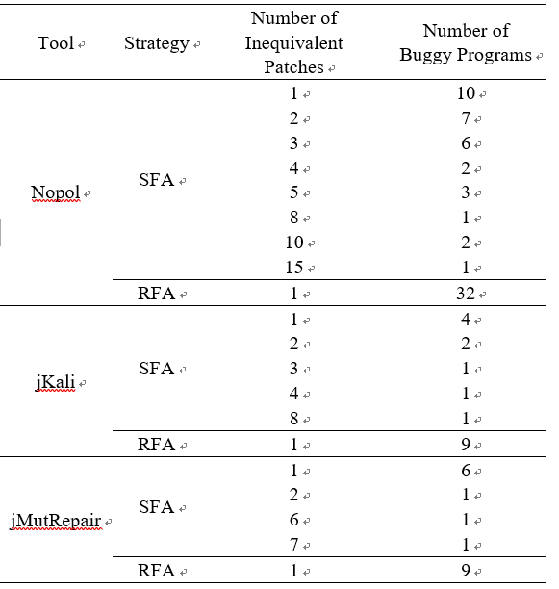
4. RQs and Evaluation
RESULT OF RQ3
SFA outperforms RFA in patch diversity by stimulating the repair tools to repair statements randomly rather than depending on the absolute rank
Notes:
The better performance achieved by SFA in patch diversity produces more inequivalent patches in repeated repair or parallel repair, thus providing more clue information to help developers find the correct patch [34]

Slide 15
5. Discussion and conclusion
Discussion
RFA-based repair tools can be easily converted into SFA-based tools, but not vice versa
Existing APR tools still select FL techniques from the viewpoint of developers
Existing studies focus too much on improving the rank accuracy with rank-based metrics (e.g., EXAM and Top-10)
CONCLUSION
RFA outperforms SFA in 64.76% cases when evaluated by NCP, while SFA performs better in parallel repair and patch diversity.
Explore the reasons behind the lower performance of SFA
Future work: construct a fault localization technique with higher suspiciousness accuracy that can benefit APR

Slide 16
Thanks

